Slide 1
Water is life
Shivam , Vidit , Aarav , Samaksh and Yugveer
5B

Slide 2
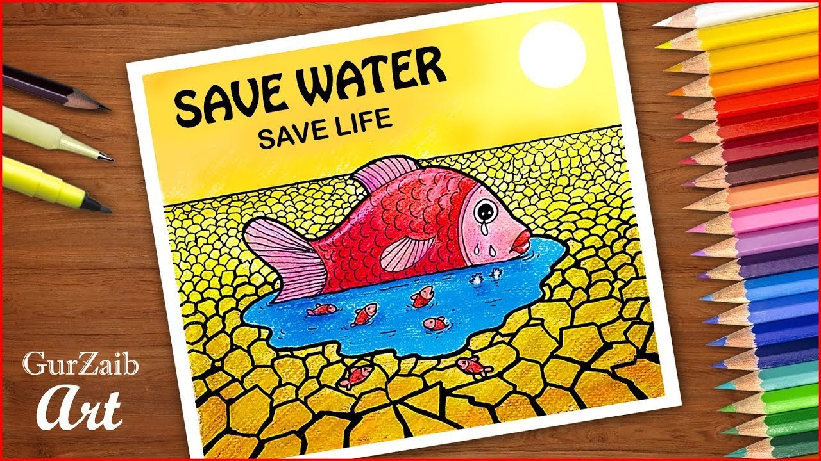

Slide 3
Fish in water

Slide 4
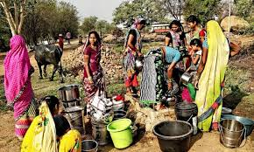

Slide 5
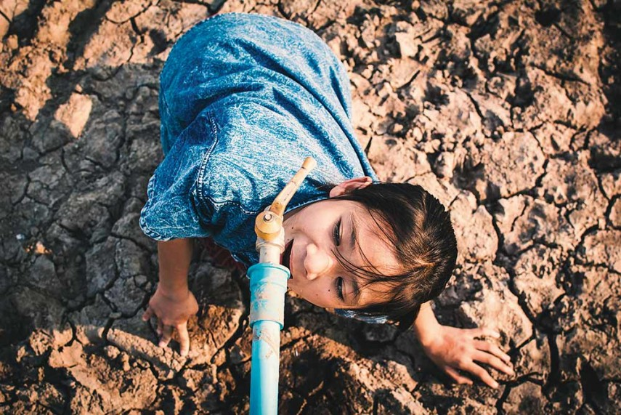

Slide 6
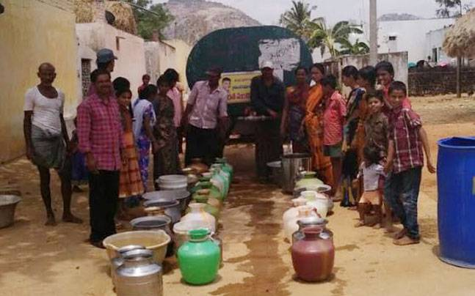

Slide 7
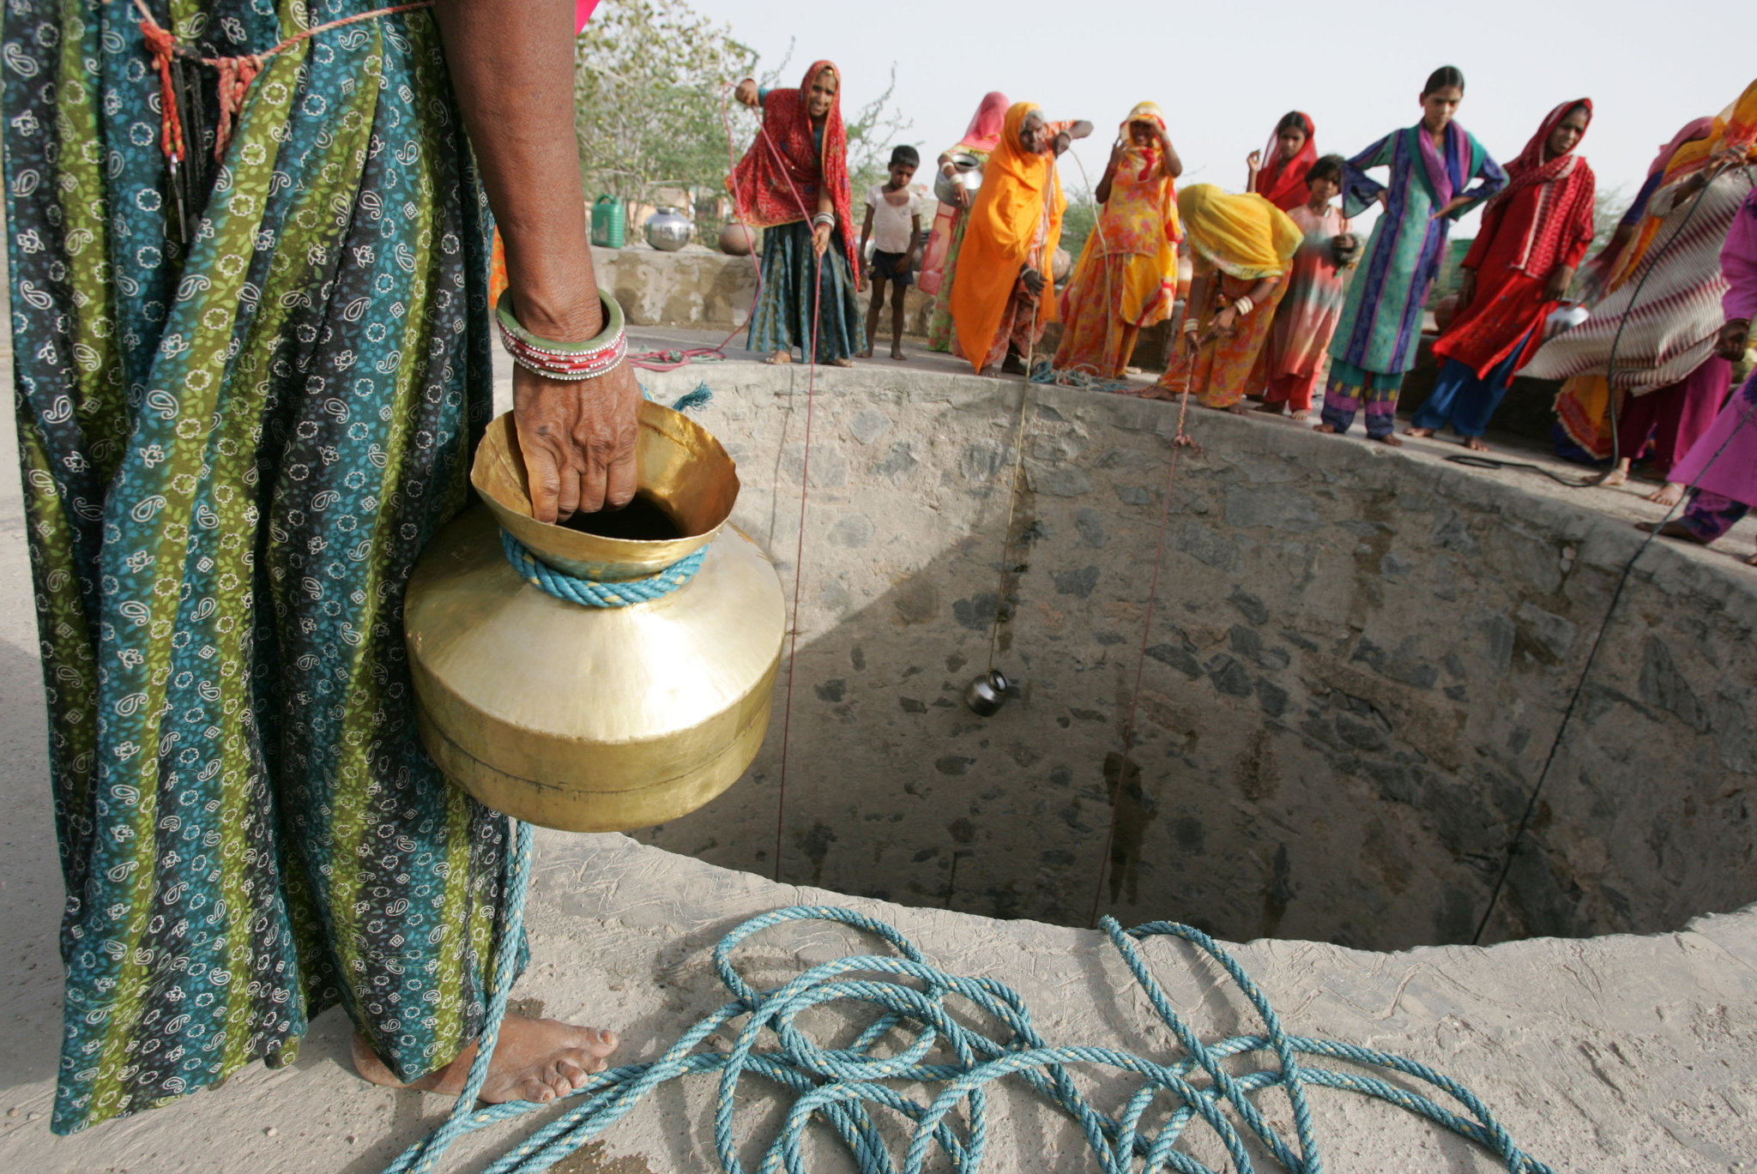

Slide 8
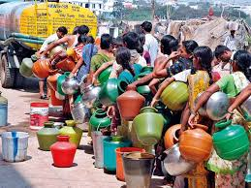

Slide 9
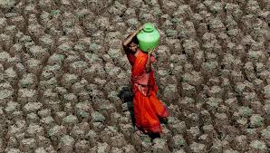

Slide 10
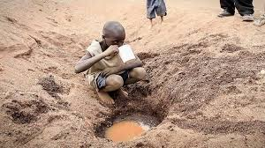

Slide 11
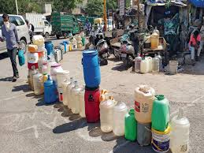

Slide 12
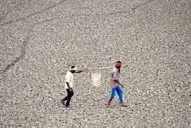

Slide 13
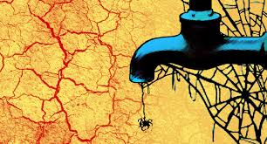

Slide 14
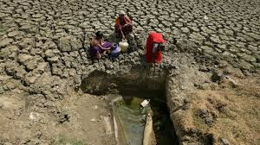

Slide 15
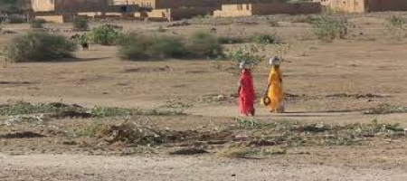

Slide 19
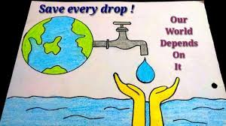

Slide 21
SAVE WATER
Fix leaky faucets, toilets, appliances and sprinklers.
Turn off the water when brushing your teeth.
Use less water when doing laundry.
Take a shower instead of a bath, and take shorter showers.
Fill a bottle with water and sand and put it in the toilet tank.
Practice smart lawn watering.
Plant native plant species in your garden.
Fill the dishwasher.

Slide 22
SAVE WATER
Purchase water-efficient faucets, laundry washers, toilets and dishwashers.
Have a home energy audit.

Slide 23
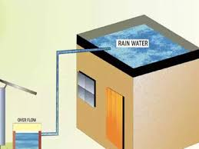
RAIN WATER HARVESTING

Slide 24
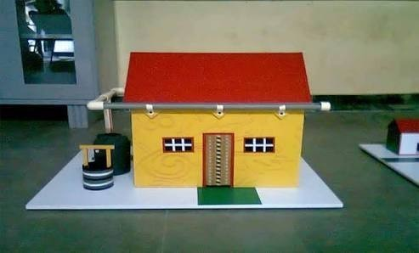

Slide 25
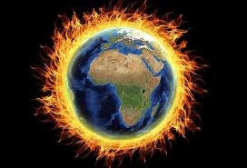
GLOBAL WARMING

Slide 26
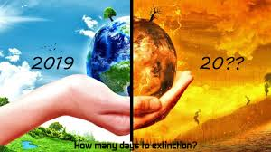

Slide 27
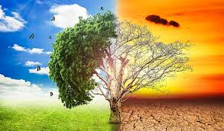

Slide 28
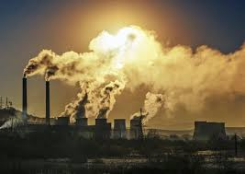

Slide 29
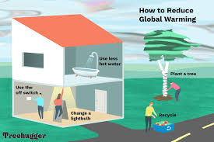
HOW TO REDUCE GLOBAL WARMING

Slide 30
HOW TO REDUCE GLOBAL WARMING.
Change a light bulb-Use a compact fluorescent bulb.
2. Drive less
Use less hot water
Check your tyres.
Reduce reuse and recycle.
Turn off electronic devices when not using.
Stay informed.
Plant a tree.
Avoid packaging.
Use thermostat.

Slide 31
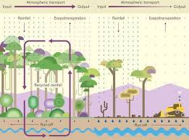
Plant more trees to get more rain

Slide 32
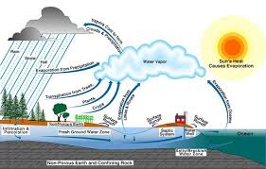
Trees can prevent floods

Slide 33
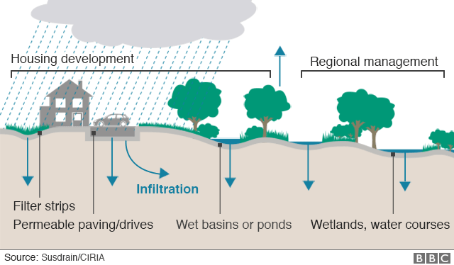
Plant trees

Slide 34
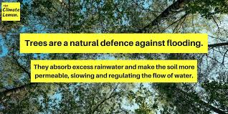

Slide 35
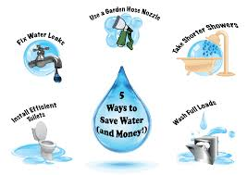
We can do our bit to save water

Slide 36
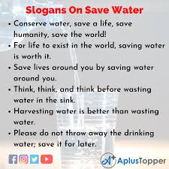

Slide 38
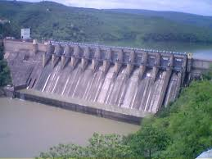

Slide 39
Use water conservation

Slide 40
Thank you

Slide 42
Save our planet earth.
Everyone do their bit.

